Slide 1

C# Async and Await Explained
Jeremy Likness
Principal Architect
@JeremyLikness

Slide 2
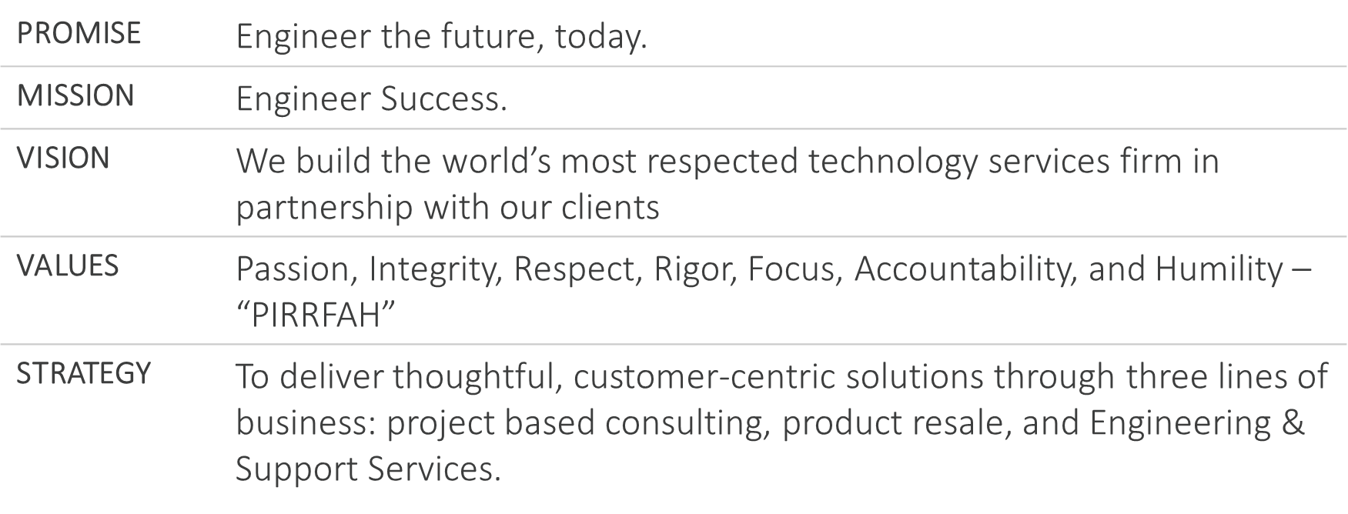
Our Mission, Vision, and Values

Slide 3
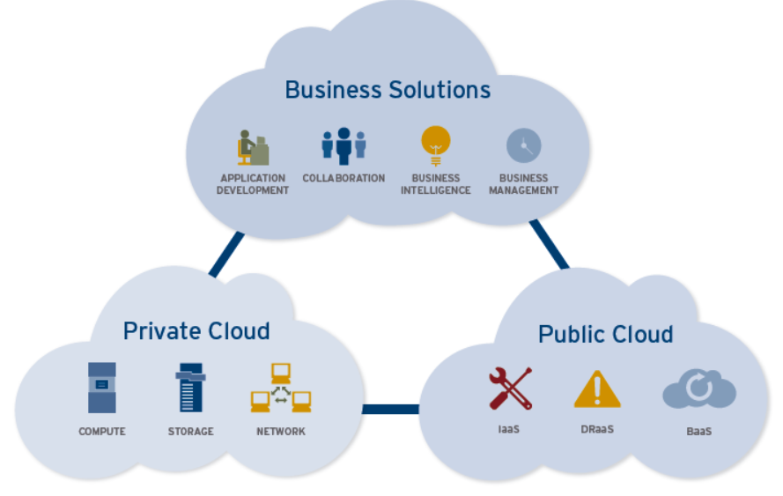
Our Solutions

Slide 4
1.
Why?
Why do we need new keywords?
2.
What?
What exactly do async and await do?
3.
How?
How and when should async and await be used?
4.
Q&A
You have questions, I have answers

Slide 5
WHY?

Slide 6
WHY? Fundamentals
Once upon a time, an OS was created to run apps
These apps would run in a process
Processes would be segregated into app domains
App domains would run threads
Process
App Domain 1
App Domain 2
Thread 1
Thread 2
Thread 3
Thread 4
Process is the running program, i.e. the .NET CLR host
App domains provide isolation from each other and can be uniquely configured, loaded, unloaded, and secured
Threads enable management of code execution

Slide 7
WHY? What’s in every thread …
Thread kernel object (context) ~1KB
Thread environment block (local storage data, graphics, exception handling) ~4KB – 8KB
User mode stack ~1MB
Kernel mode stack ~20KB

Slide 8
WHY? The life of one thread…
Initialize memory
Thread attach notifications sent to every DLL in the process
Execute code
Context Switch
Execute Code
Thread detach notifications
Deallocate memory

Slide 9
WHY? Thread scheduling (1 core)
Run thread 1
Save registers (~30ms later)
Select next thread
Run thread 2
Save registers (~30ms later)
Select next thread …
Switch virtual address space
Load registers

Slide 10
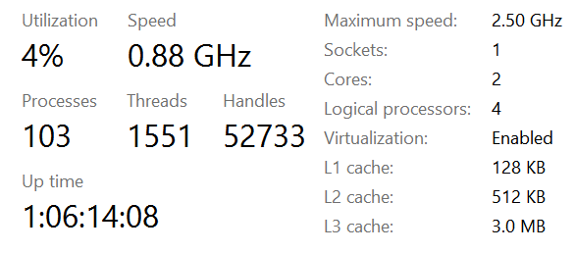
WHY? And to think …

Slide 11
DEMO: Threads
Notes:
01Threads

Slide 12
WHY? A Dip in the Thread Pool
We agree threads have overhead
To address this, the CLR introduces the thread pool
Starts out empty
As tasks are dispatched, threads are created
When thread is done, it is returned to the pool and recycled
Trade-offs exist:
Less overhead (memory pressure)
Less time to allocate/spin up a thread
However, fewer threads are scheduled concurrently

Slide 13
DEMO: Thread Pool
Notes:
02ManyTasksNoThreadPool, 03ManyThreadsThreadPool

Slide 14
WHY? Tasks
Make it easier to deal with threads and the thread pool
Easy to wait
Automatic ability to cancel
Simple access to result
Chainable tasks (one starts when the other finishes)
Child tasks
Parallel functions

Slide 15
DEMO: Tasks
Notes:
04Tasks, 05Parallel

Slide 16
WHY? I/O Operations
Make I/O Request
I/O Request Packet
Thread Goes to Sleep
Thread Wakes Up
Device Driver Queue
Driver Does I/O

Slide 17
WHY? Synchronous: Two Threads
Handle Request
Blocked I/O
Complete
Handle Request
Blocked I/O
Complete

Slide 18
WHY? Asynchronous: One Thread
Handle Request
Handle Request
Complete
Complete
Asynchronous
Asynchronous

Slide 19
DEMO: Asynchronous
Notes:
06Asynchronous

Slide 20
WHAT?

Slide 21
What? async
Expecting to use await
Does not create new thread, always uses same thread as caller
After await may or may not use same thread (thread pool is involved, so threads are reusable)
If a SynchronizationContet exists, it will return to that thread
You can also modify this behavior using ConfigureAwait
Basically … think “yield” for threads!

Slide 22
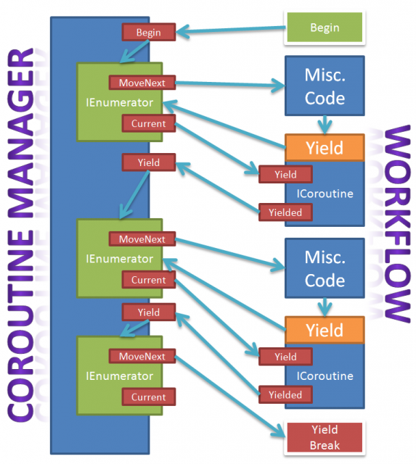
What? Yield: a refresher

Slide 23
DEMO: Async
Notes:
07AsyncAwait, 07bAsyncAwaitWithContext, 08NoAsyncAwait

Slide 24
Best Practices
Never async void (use Task instead)
Exceptions can’t be caught so they are thrown in the context (if you have one!)
Made specifically for event handlers
If you must use for event handler, try to isolate the majority of code in another await that does return a Task
Never mix async and blocking code together
Task.Wait, Task.Result are generally bad ideas
Exception is a console application
From the necessary static main, promote to an async static main with a wait
Task.Wait should become Task.When

Slide 25
HOW?

Slide 26
How?
More impactful for I/O bound than compute-bound
Remember the Fibonacci examples?
Check this out …

Slide 27
DEMO: Async ThreadPool
Notes:
09AsyncThreadPool

Slide 28
How?
“I usually don’t work with multi-threading”
If you are working on the web, you are in a multi-threaded environment
If you are I/O bound, you should take advantage
Entity Framework now supports asynchronous methods!
The transformation is simple …

Slide 29
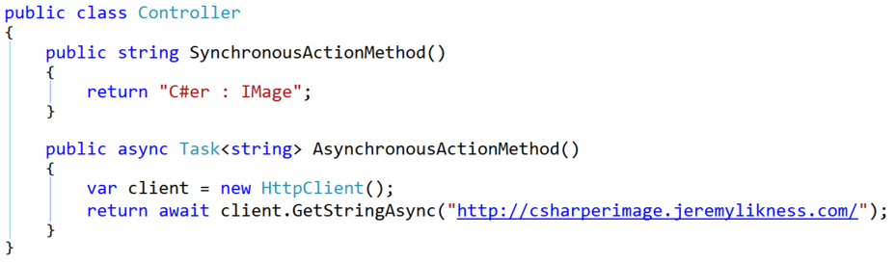
How? Asynchronous Controllers

Slide 30
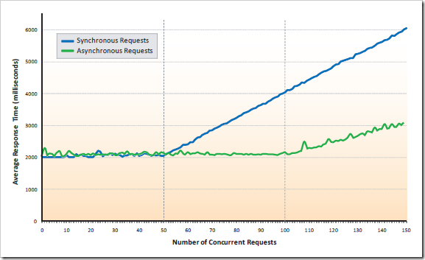
How? Real World Results
Source: http://blog.stevensanderson.com/2010/01/

Slide 31
How? Windows 8.x / 10 or whatever
Windows Runtime (WinRT)
IAsyncInfo
IAsyncAction
IAsyncOperation<TResult>
IAsyncActionWithProgress<TProgress>
IAsyncOperationWithProgress<TResult, TProgress>
ThreadPool.RunAsync
IAsyncInfo.AsTask()

Slide 32
Recap
You are always working with multi-threaded, don’t sell yourself short!
Compute-bound does not benefit as much from asynchronous as you might think, except to free the main context (typically your UI thread)
I/O has tremendous benefits
Async does not spin up a new thread. Instead, it establishes a state machine and makes the thread reusable and re-entrant
Await is not like Wait() because it doesn’t block and it allows you to recycle threads
If you have async I/O then USE IT! Async Task<> is your friend.

Slide 33
Deck and Source
https://github.com/JeremyLikness/AsyncAwaitExplained

Slide 34





Questions?
http://ivision.com/author/jlikness/
@JeremyLikness
http://linkedin.com/in/jeremylikness http://plus.google.com/+jeremylikness http://stackoverflow.com/users/228918/jeremy-likness https://github.com/JeremyLikness http://csharperimage.jeremylikness.com/

